Slide 1
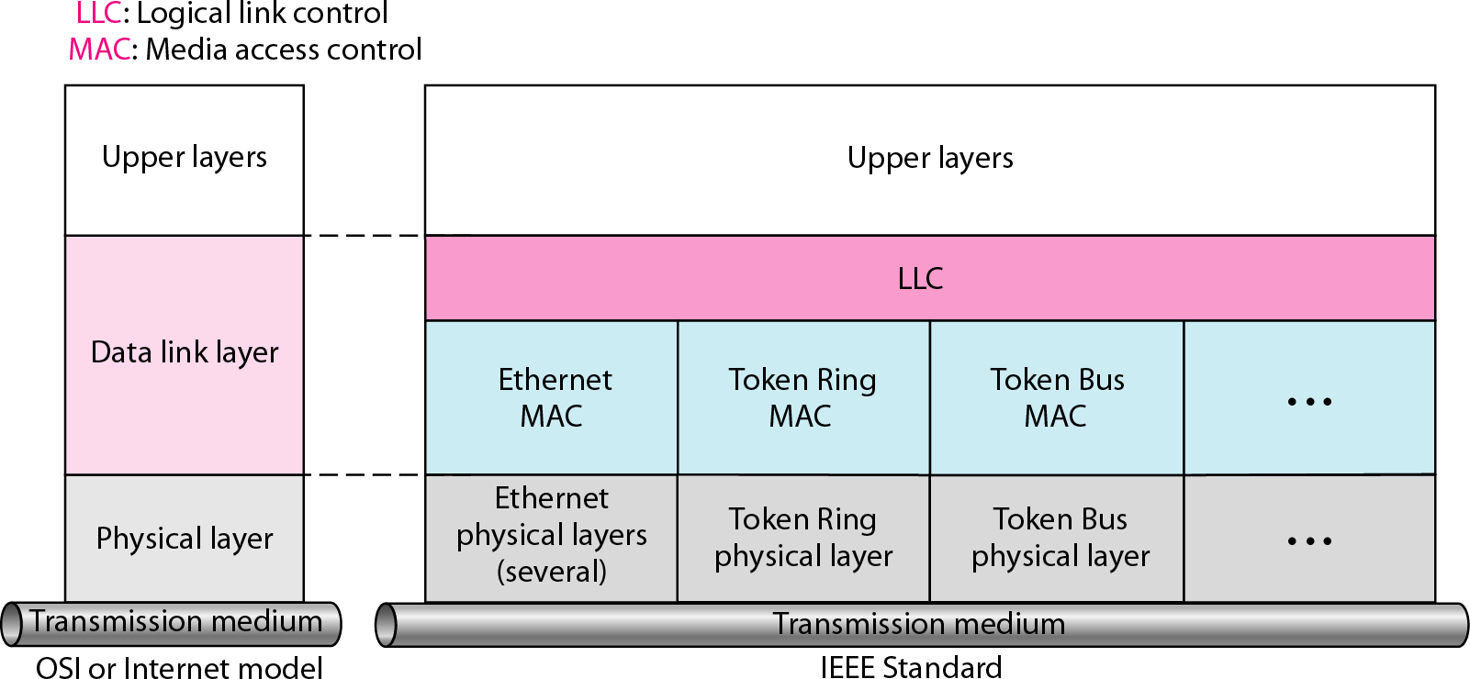
IEEE standard for LANs

Slide 2







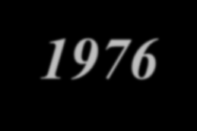














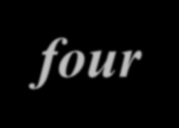







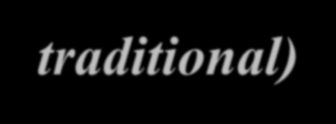

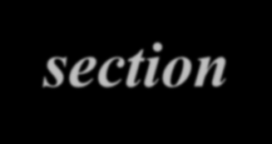

STANDARD ETHERNET
The original Ethernet was created in 1976 at Xerox’s Palo Alto Research Center (PARC). Since then, it has gone through four generations. We briefly discuss the Standard (or traditional) Ethernet in this section.
Topics discussed in this section:
MAC Sublayer
Physical Layer

Slide 3
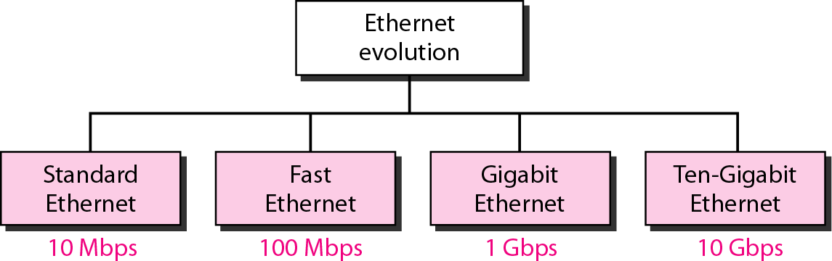
Ethernet evolution through four generations

Slide 4
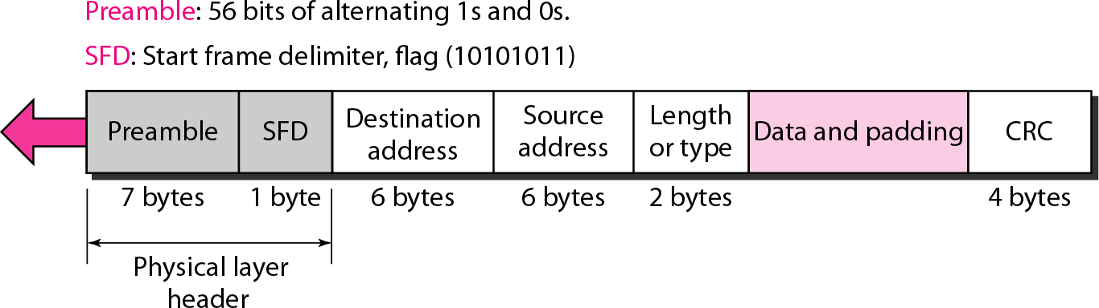
802.3 MAC frame

Slide 5
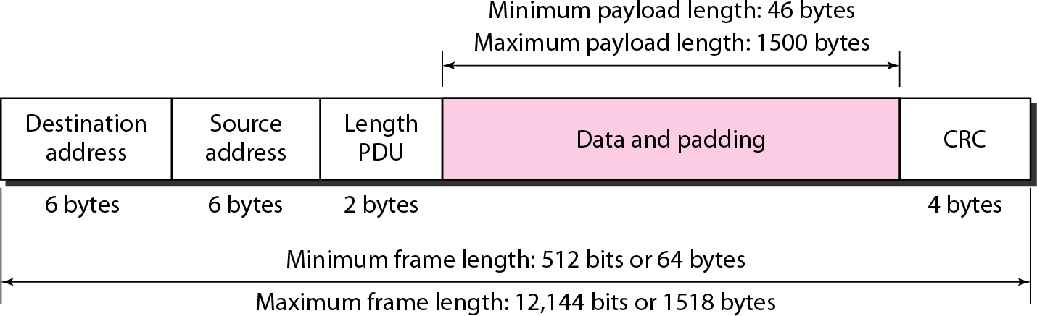
Minimum and maximum lengths

Slide 6

Note
Frame length: Minimum: 64 bytes (512 bits)
Maximum: 1518 bytes (12,144 bits)

Slide 7
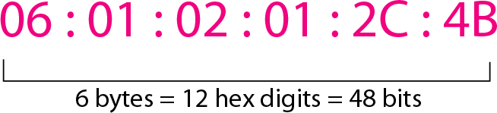
Example of an Ethernet address in hexadecimal notation

Slide 8
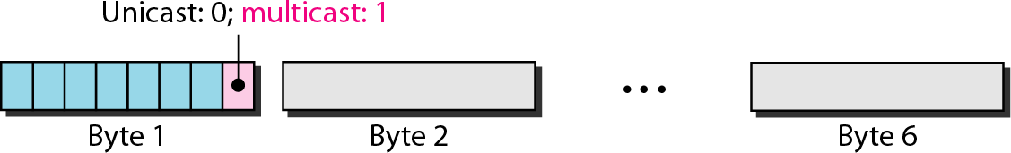
Unicast and multicast addresses

Slide 9
Note
The least significant bit of the first byte defines the type of address.
If the bit is 0, the address is unicast; otherwise, it is multicast.

Slide 10



Note
The broadcast destination address is a special case of the multicast address in which all bits are 1s.
13.10

